Slide 1
WHERE DO I STAND?

Slide 2

WHAT ARE MY VALUES?

Slide 3
DEFINING MY VALUES
Your values are the things that you believe are important in the way you live and work.
They (should) determine your priorities, and, deep down, they're probably the measures you use to tell if your life is turning out the way you want it to.
When the things that you do and the way you behave match your values, life is usually good – you're satisfied and content. But when these don't align with your personal values, that's when things feel wrong. This can be a real source of unhappiness.
This is why making a conscious effort to identify your values is so important.

Slide 4
HOW VALUES HELP ME?
Values exist, whether you recognize them or not.
Life can be much easier when you acknowledge your values – and when you make plans and decisions that honor them.
If you value family, but you have to work 70-hour weeks in your job, will you feel internal stress and conflict? And if you don't value competition, and you work in a highly competitive sales environment, are you likely to be satisfied with your job?

Slide 5
In these types of situations, understanding your values can really help. When you know your own values, you can use them to make decisions about how to live your life, and you can answer questions like these:
What job should I pursue?
Should I accept this promotion?
Should I start my own business?
Should I compromise, or be firm with my position?
Should I follow tradition, or travel down a new path?
So, take the time to understand the real priorities in your life, and you'll be able to determine the best direction for you and your life goals !

Slide 6
REMEMBER
Values are usually fairly stable, yet they don't have strict limits or boundaries. Also, as you move through life, your values may change.
For example, when you start your career, success – measured by money and status – might be a top priority.
But after you have a family, work-life balance may be what you value more.
As your definition of success changes, so do your personal values. This is why keeping in touch with your values is a lifelong exercise.
You should continuously revisit this, especially if you start to feel unbalanced... and you can't quite figure out why.
As you go through the exercise below, bear in mind that values that were important in the past may not be relevant now.

Slide 7

DEFINING VALUES FOR YOU

Slide 8
When you define your personal values, you discover what's truly important to you.
A good way of starting to do this is to look back on your life – to identify when you felt really good, and really confident that you were making good choices.
STEP 1- IDENTIFY THE TIME WHEN YOU WERE THE HAPPIEST.
Find examples from both your career and personal life. This will ensure some balance in your answers.
- What were you doing?
- Were you with other people? Who?
- What other factors contributed to your happiness?

Slide 9
STEP 2 – IDENTIFY THE TIME WHEN YOU WERE PROUD OF YOURSELF.
Use examples from your career and personal life.
Why were you proud?
Did other people share your pride? Who?
What other factors contributed to your feelings of pride?

Slide 10
STEP 3 – IDENTIFY THE TIME WHEN YOU FELT MOST FULFILLED AND SATISFIED.
Use examples from your career and personal life.
Why did you feel satisfied?
Did other people share your satisfaction and fulfillment? Who?
What other factors contributed to your feelings?

Slide 11
STEP 4 – DETERMINE YOUR TOP VALUES BASED ON YOUR EXPERIENCES OF HAPPINESS, PRIDE & FULFILLMENT.
Why is each experience truly important and memorable?
Use the following list of common personal values to help you get started – and aim for about 10 top values. (As you work through, you may find that some of these naturally combine.
For instance, if you value philanthropy, community, and generosity, you might say that service to others is one of your top values.)

Slide 12
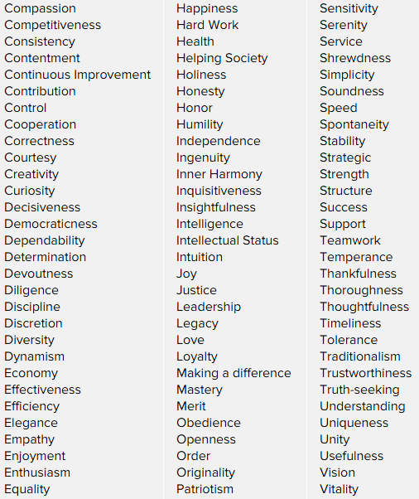

Slide 13
STEP 5 – PRIORITIZE YOUR TOP VALUES.
This step is probably the most difficult, because you'll have to look deep inside yourself.
It's also the most important step, because, when making a decision, you'll have to choose between solutions that may satisfy different values.
This is when you must know which value is more important to you.

Slide 14
Write down your top values, not in any particular order.
Look at the first two values and ask yourself, "If I could satisfy only one of these, which would I choose?" It might help to visualize a situation in which you would have to make that choice.
For example, if you compare the values of service and stability, imagine that you must decide whether to sell your house and move to another country to do valuable foreign aid work, or keep your house and volunteer to do charity work closer to home.
Keep working through the list, by comparing each value with each other value, until your list is in the correct order.

Slide 15
STEP 6 – REAFFIRM YOUR VALUES.
Check your top-priority values, and make sure they fit with your life and your vision for yourself.
Do these values make you feel good about yourself?
Are you proud of your top three values?
Would you be comfortable and proud to tell your values to people you respect and admire?
Do these values represent things you would support, even if your choice isn't popular, and it puts you in the minority?

Slide 16
When you consider your values in decision making, you can be sure to keep your sense of integrity and what you know is right, and approach decisions with confidence and clarity.
You'll also know that what you're doing is best for your current and future happiness and satisfaction.
Making value-based choices may not always be easy.
However, making a choice that you know is right is a lot less difficult in the long run.

Slide 17
KEYPOINTS
Identifying and understanding your values is a challenging and important exercise.
Your personal values are a central part of who you are – and who you want to be.
By becoming more aware of these important factors in your life, you can use them as a guide to make the best choice in any situation.
Some of life's decisions are really about determining what you value most.
When many options seem reasonable, it's helpful and comforting to rely on your values – and use them as a strong guiding force to point you in the right direction.

Slide 18


